Slide 1
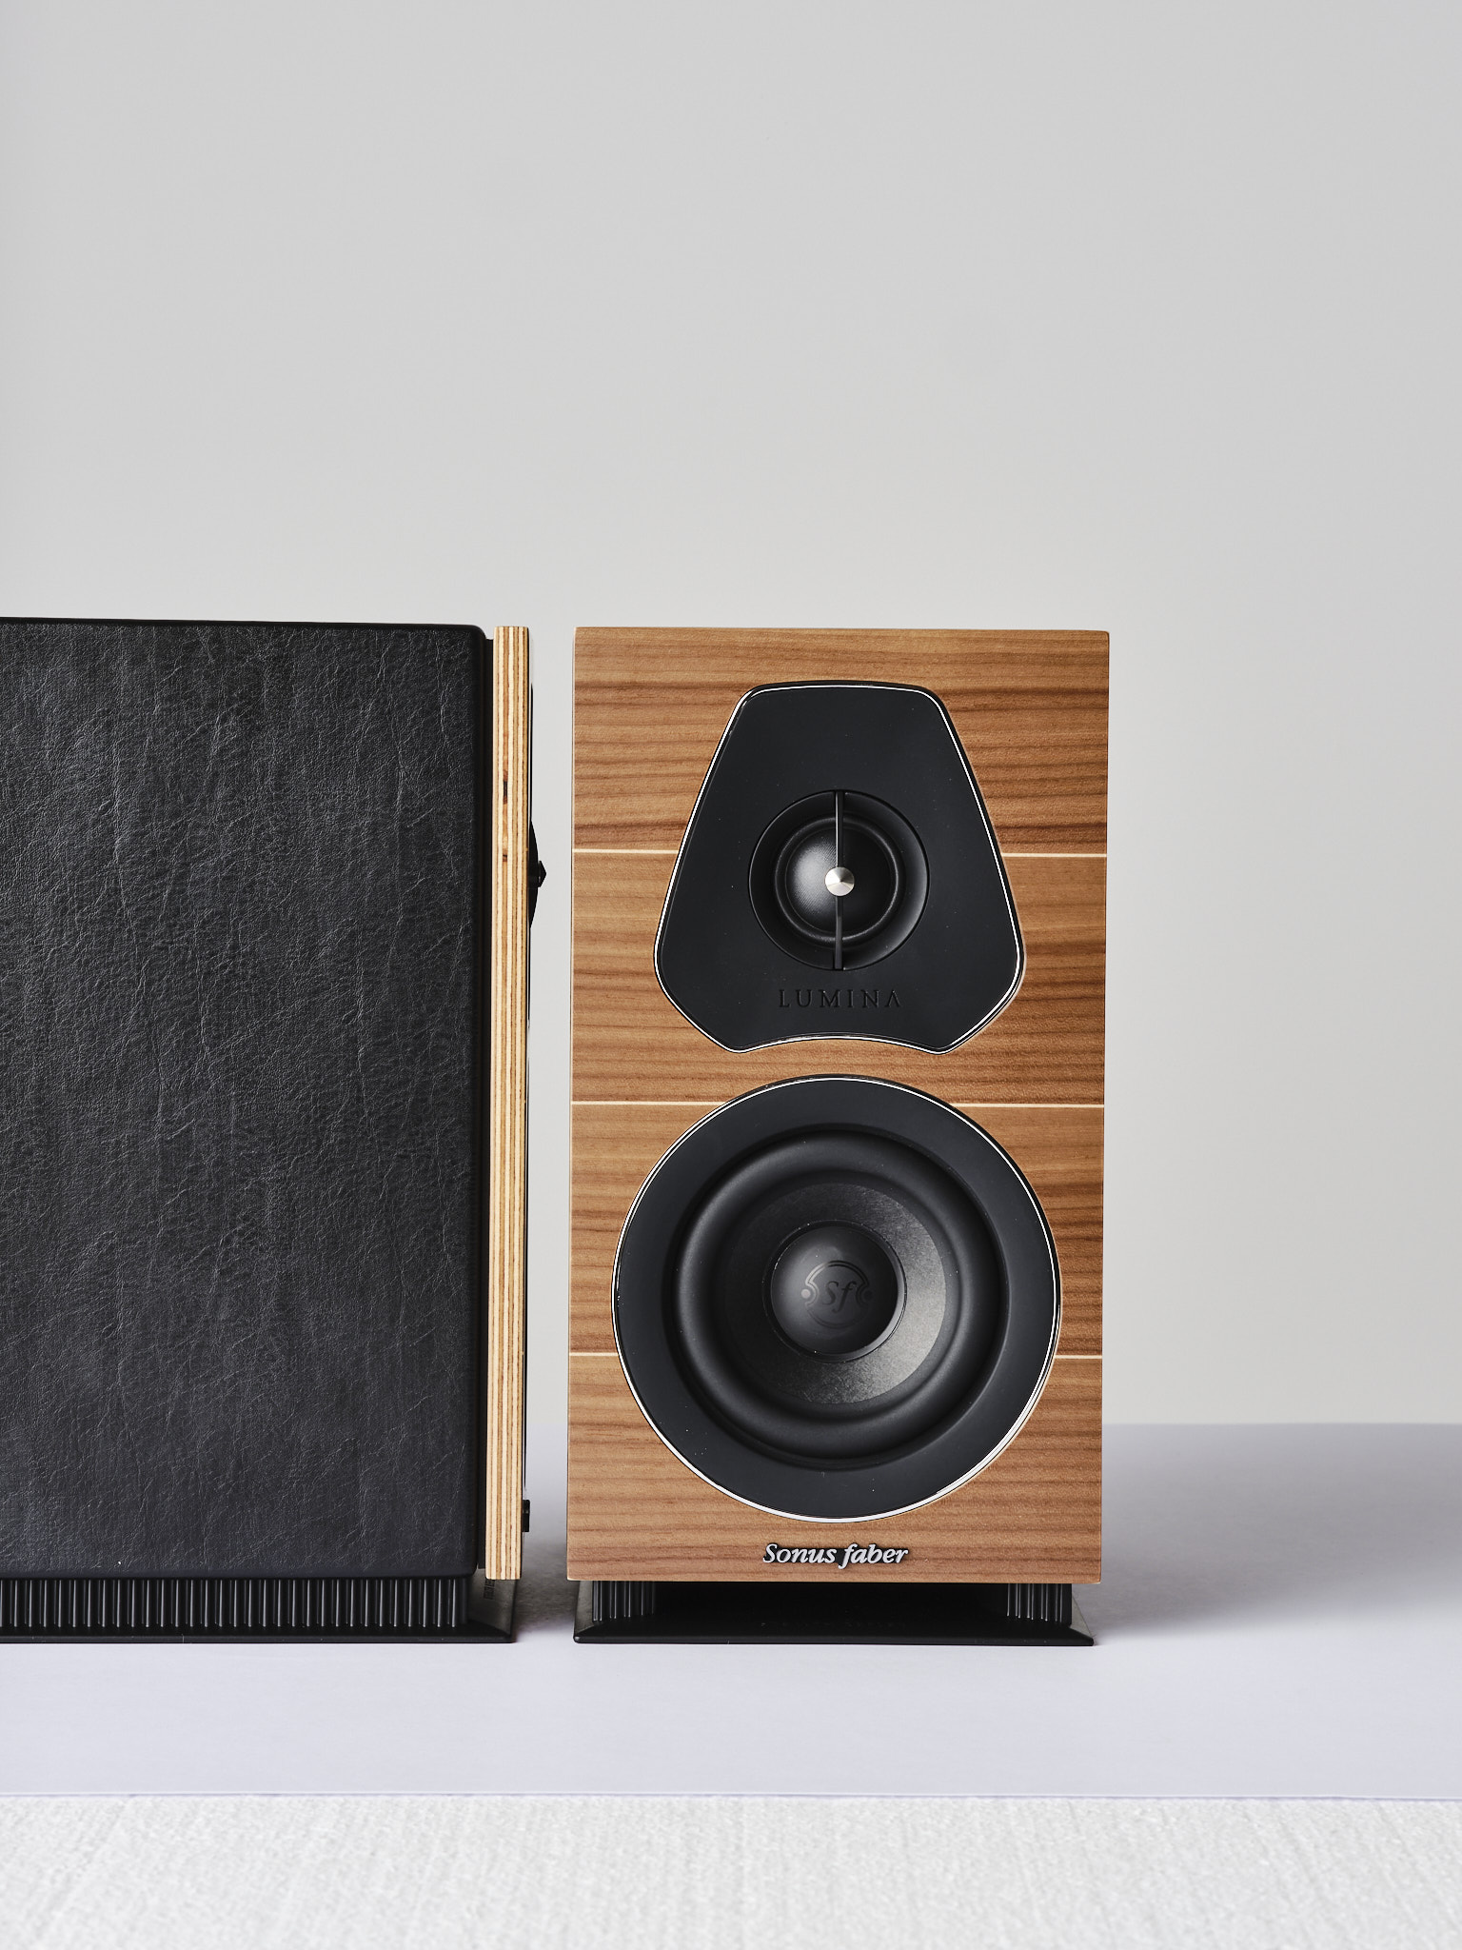
The taste of simplicity

Slide 2
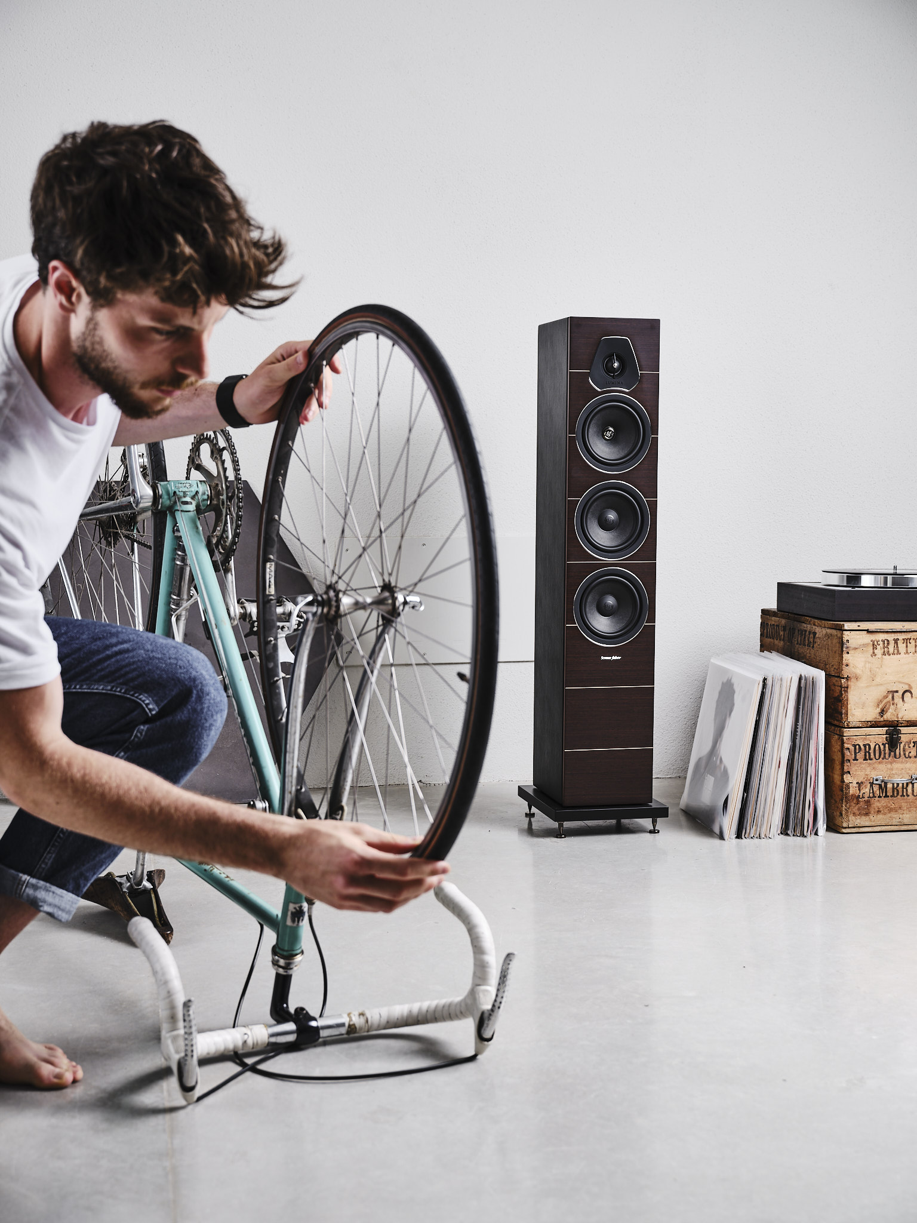
Today, more than ever, it is important to find TIME FOR OUR-SELVES, time to savor truly relevant things in life and to learn to appreciate those precious moments.
We recently learnt to give importance to our LIVING SPACES: our houses have always been the space where those PRECIOUS MOMENTS were accommodated, have always being the place where you can find yourself over and over again.

Slide 3
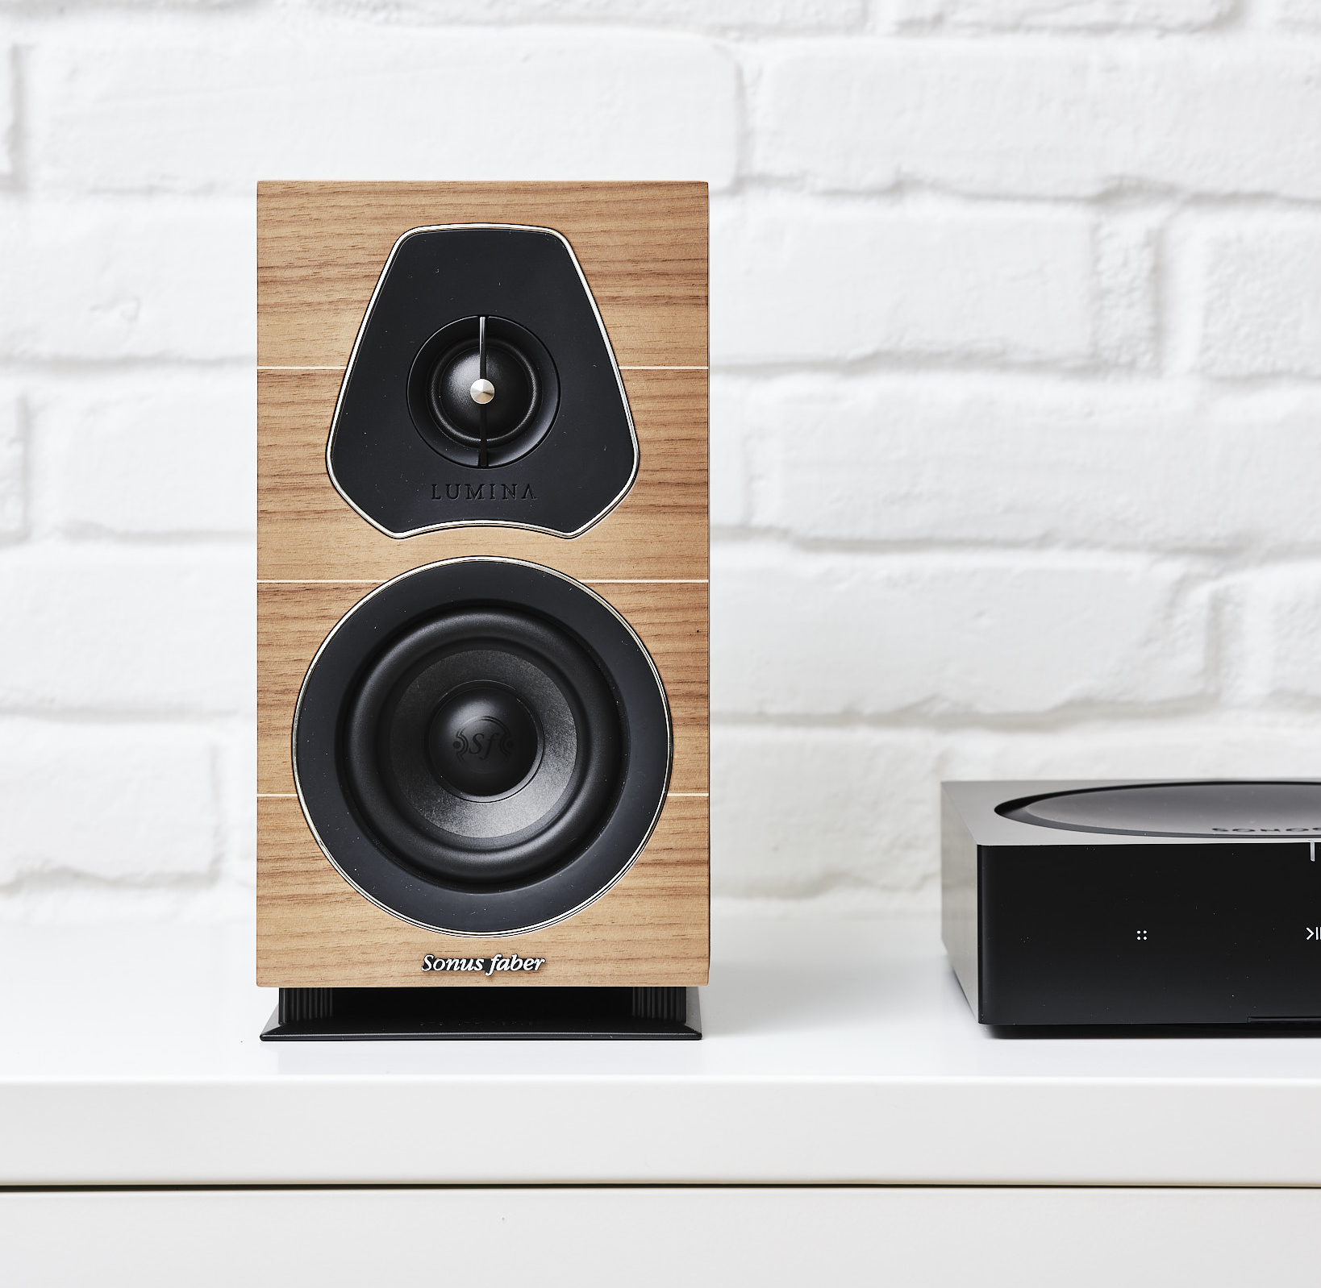
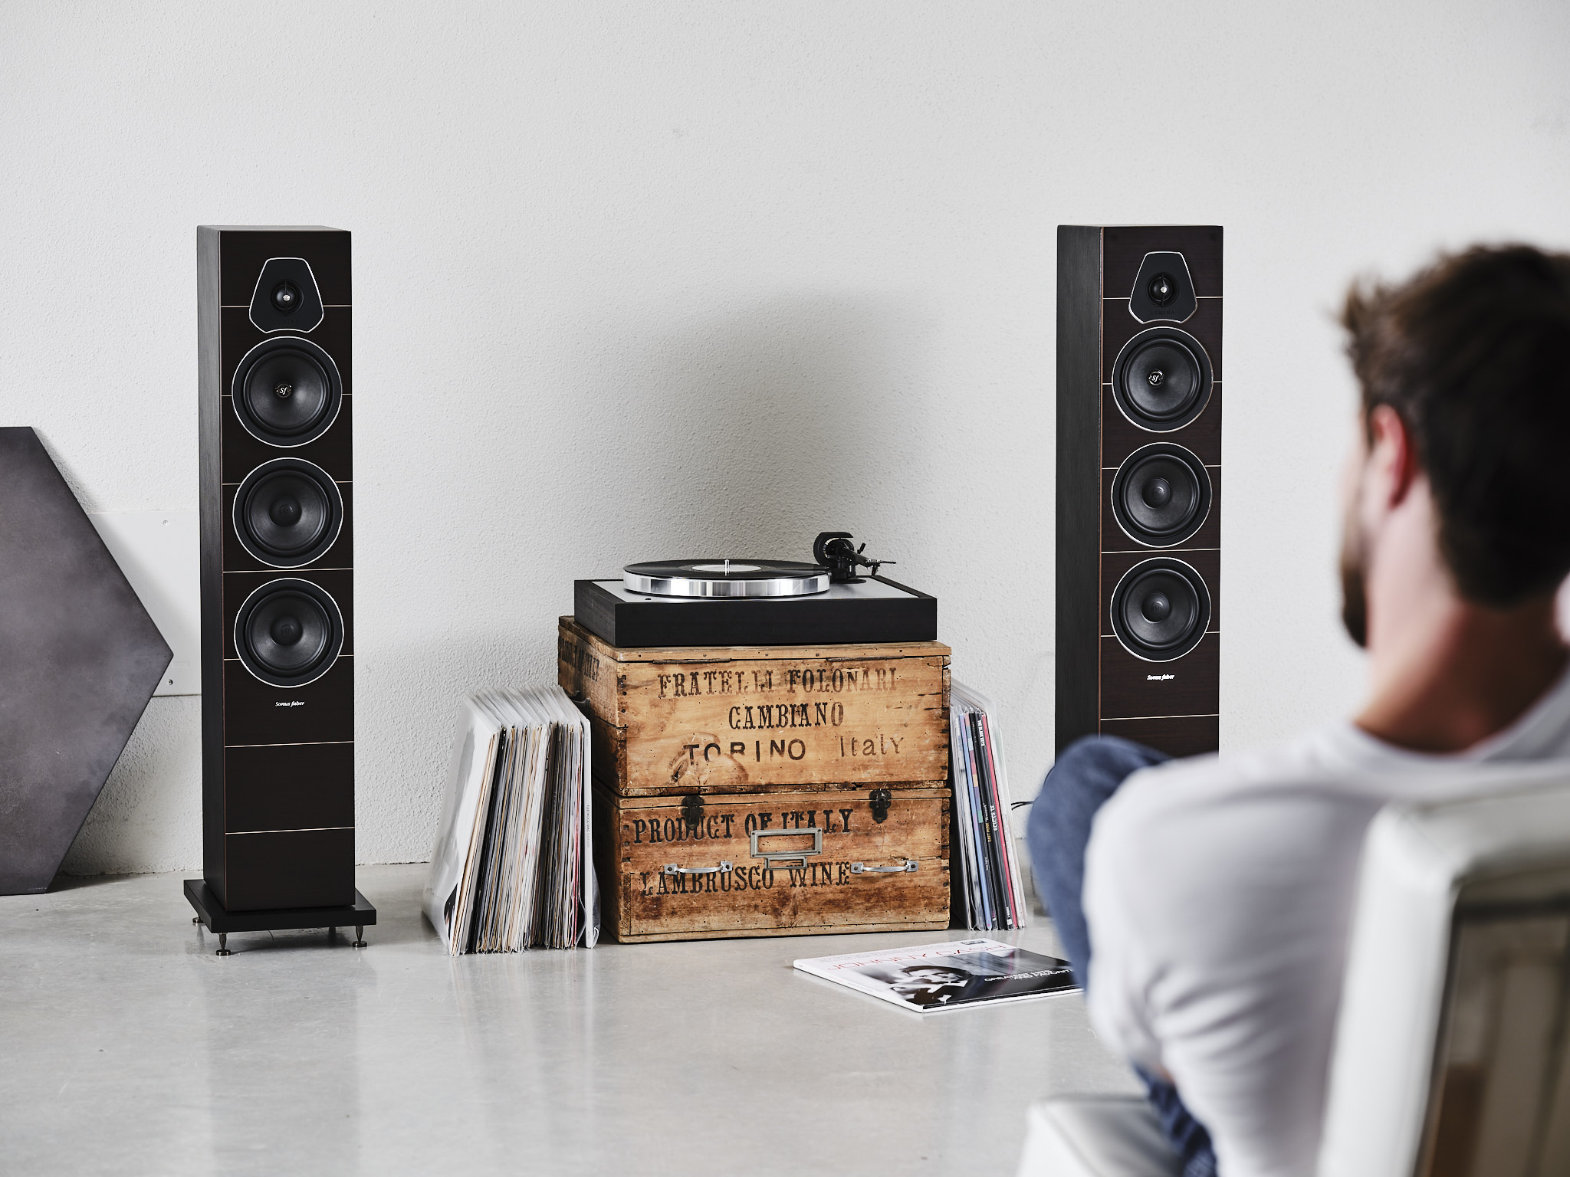
MUSIC is one of the basic ingredients defining the way we live our homes because it makes us feeling better, it gives SHAPE TO OUR EMOTIONS, it creates a sense of belonging and participation that starts in our houses and ends producing a cohesive society.
EVERYONE DESERVES THE TRUE SOUND OF MUSIC IN HIS HOME.

Slide 4
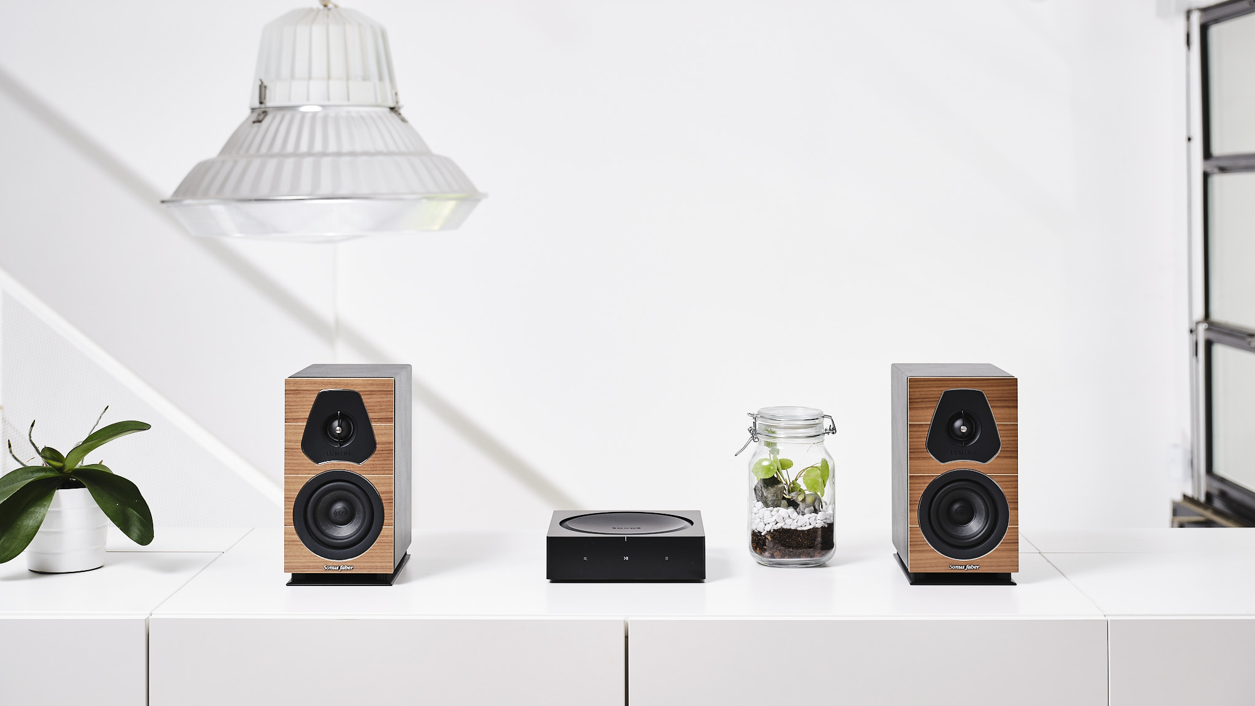
Simplicity is the key concept that guided the design of the brand-new Lumina collection
THE NEW “FIRST STEP” INTO THE SONUS FABER WORLD.
Lumina is MADE IN ITALY, EASY TO SET-UP, able to provide GREAT SOUND performance at an ACCESSIBLE PRICE POINT, empowering everyone to enjoy a true Sonus faber experience.

Slide 5
“Lumina”, in Latin means “light”, but also source of energy and life.
To us, this name has also additional meanings, comprise in the letters that make up the whole name, becoming a sort of acronym:
“LUXURY”, in our view, is the taste of precious moments, the discovery of refined details and the understanding of truly relevant things. This world talks about our commitment in delivering a luxury experience of music in everybody’s house, and our tradition of refined materials and careful craftsmanship.
“MINIMAL” refers to a design approach directly aiming to the essence of things and believing that “Less is more”. The collection comprises the core values of the brand combining them with the ability of delivering an incredible performance in a simple design package.
“NATURAL” is linked to the pursuit of the most natural sound reproduction: the main Sonus faber commitment, as established in the brand manifesto.
The electro-acoustic project is targeting solutions designed for medium to small environments, with no compromise in terms of performances and always able to deliver musicality.

Slide 6
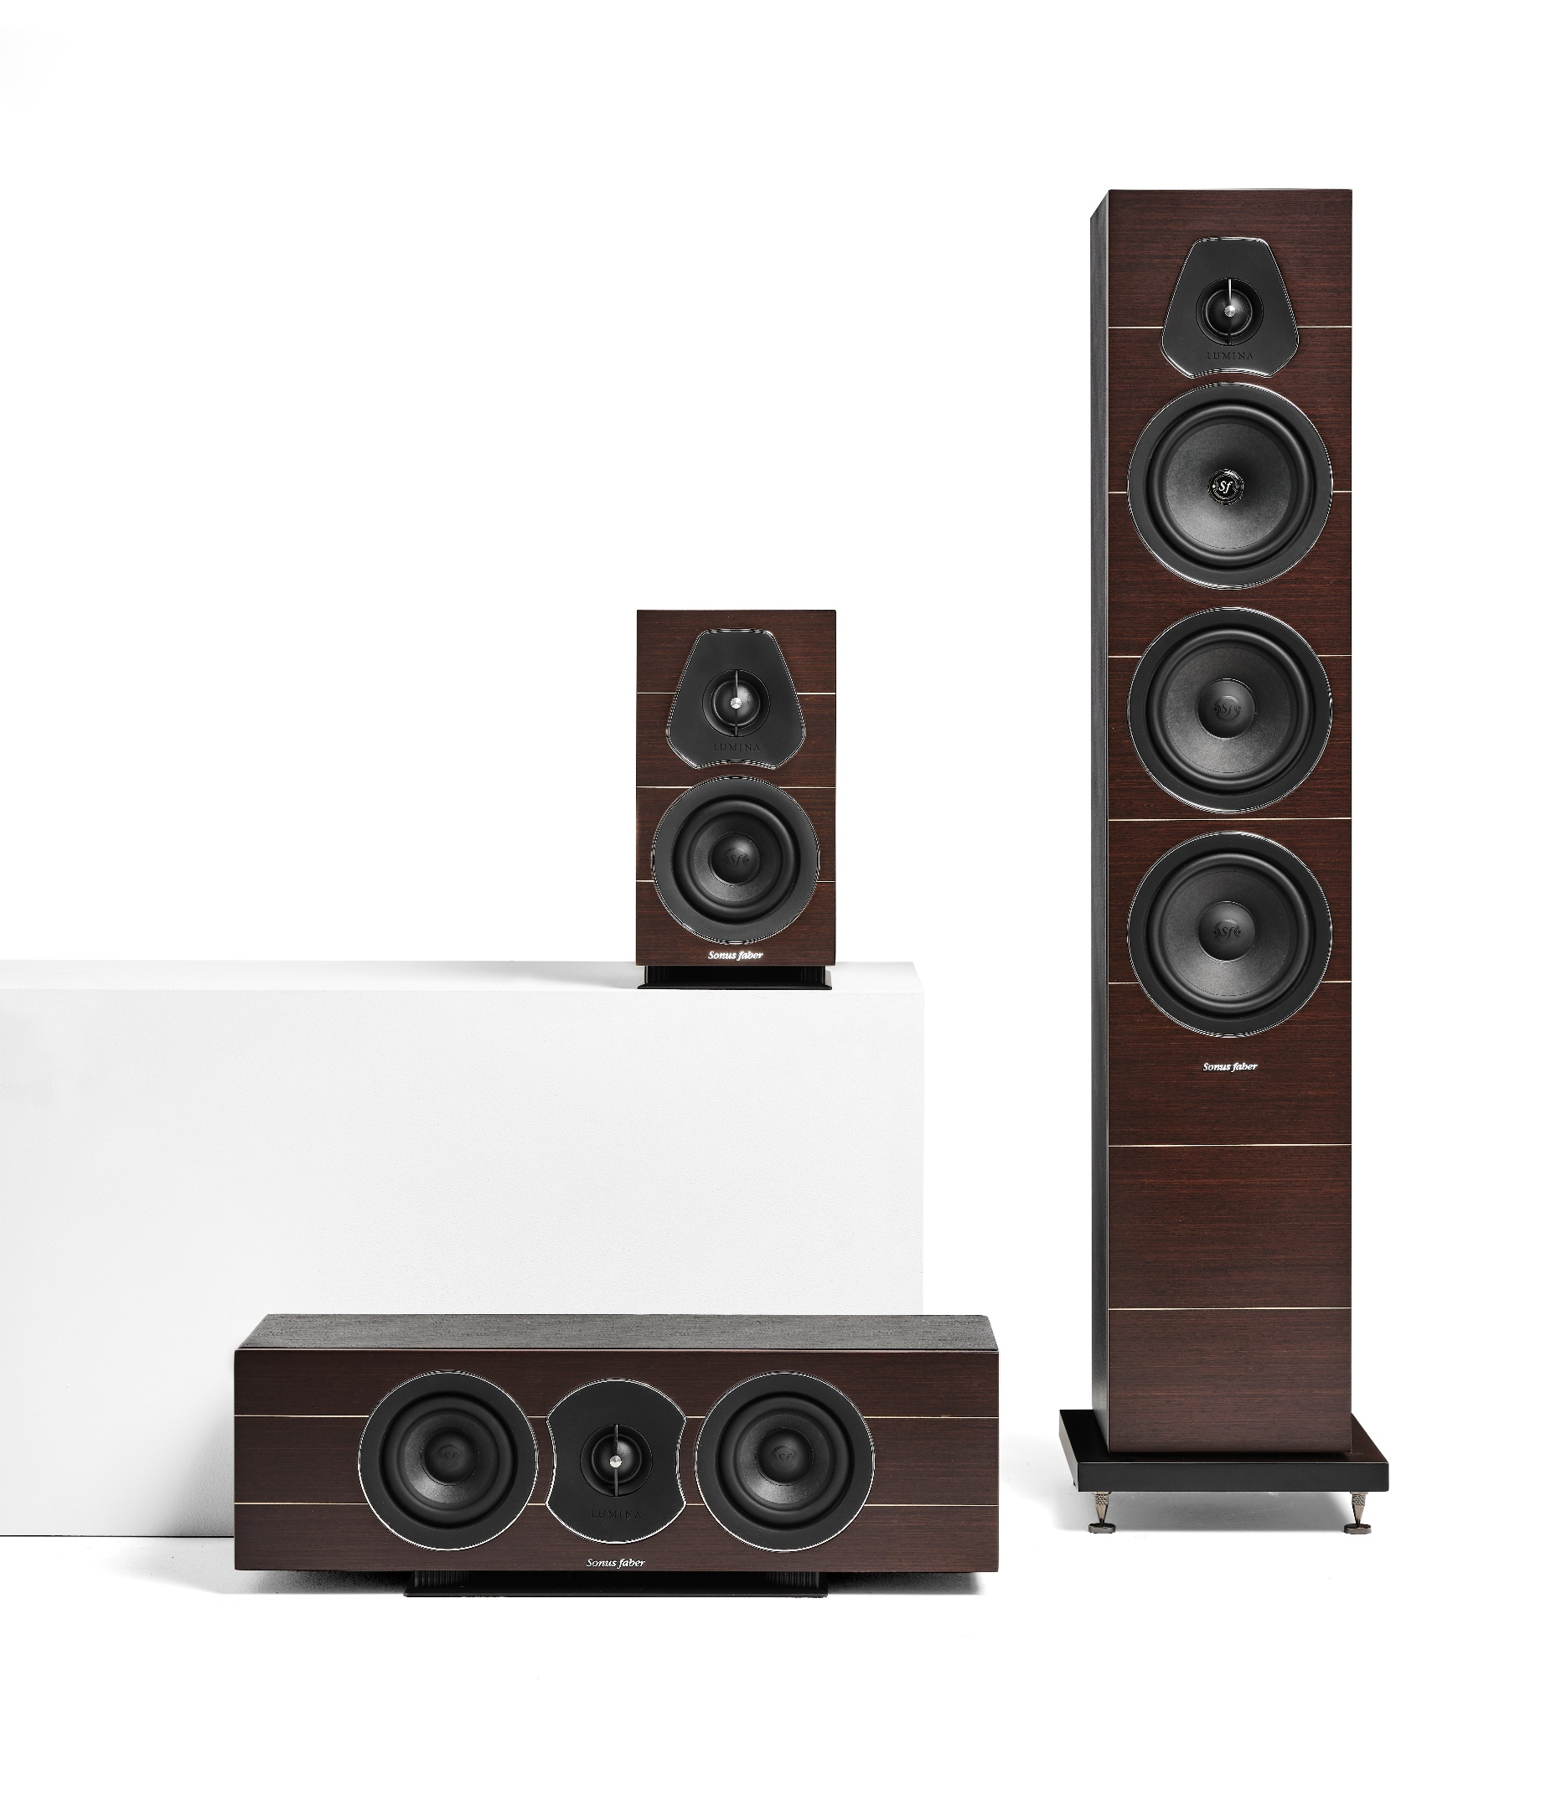
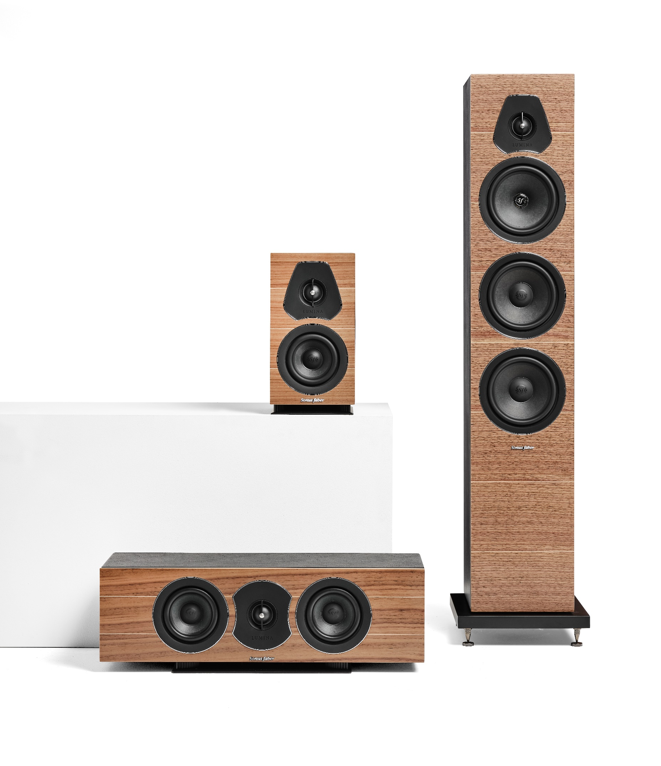
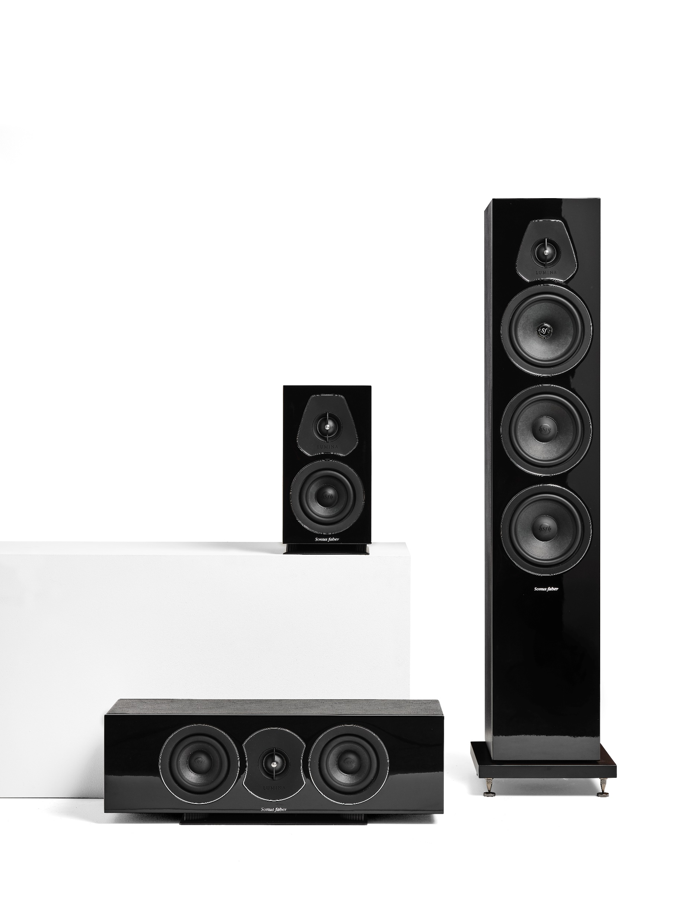
Lumina collection features three models: Lumina I, an extremely compact bookshelf speaker, Lumina III an elegant floor-standing model, and Lumina Center a center channel speaker option.

Slide 7
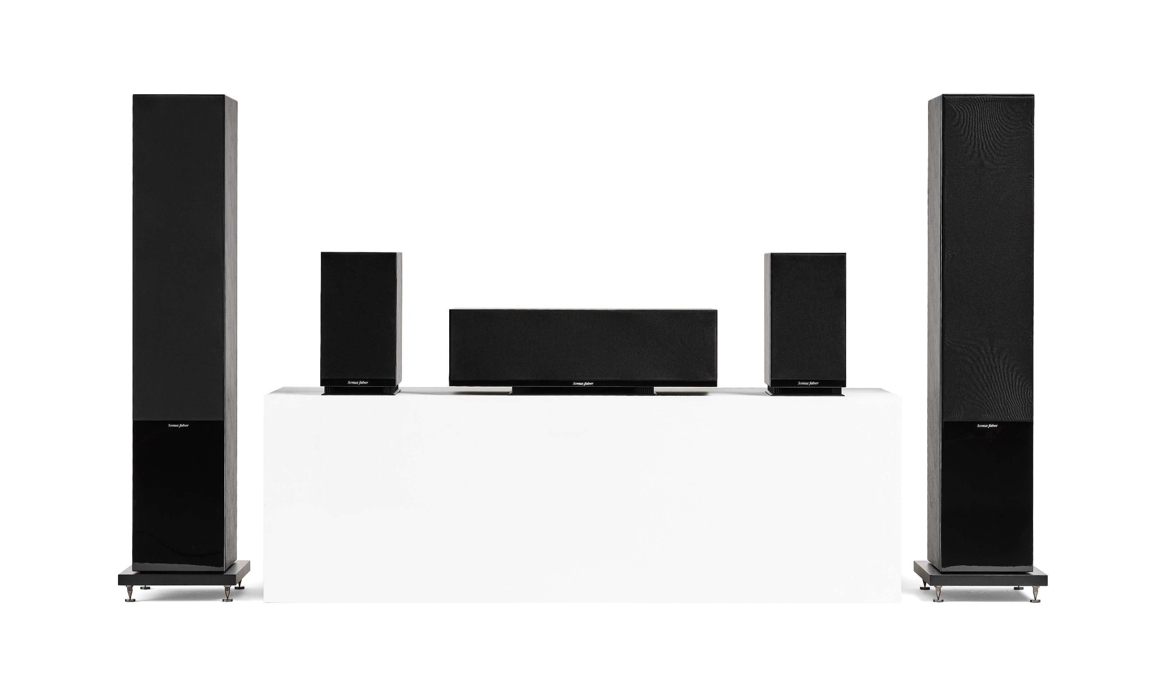
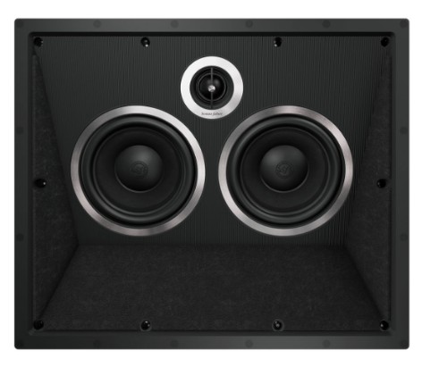
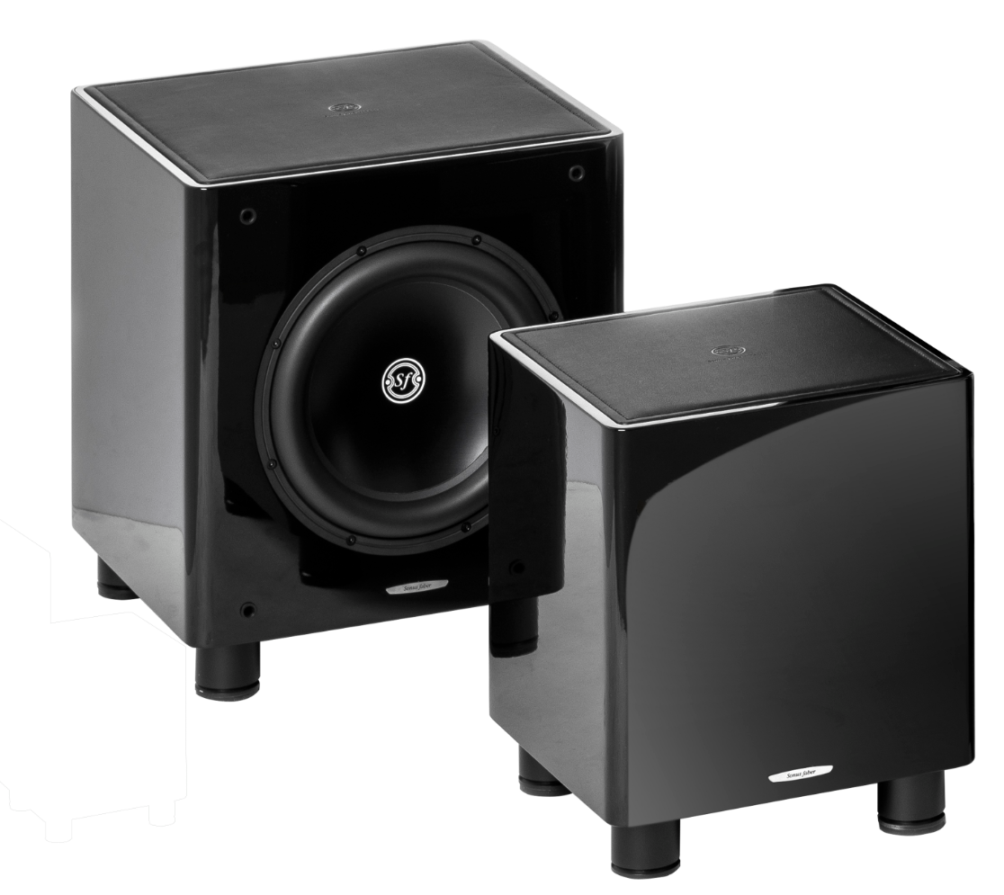
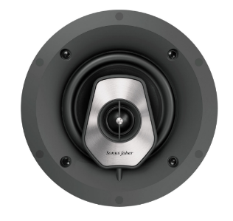
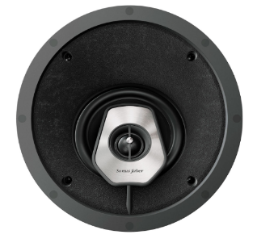
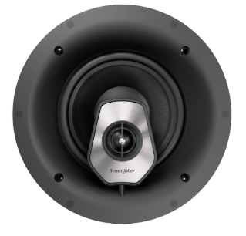
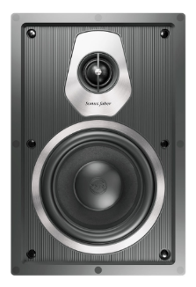
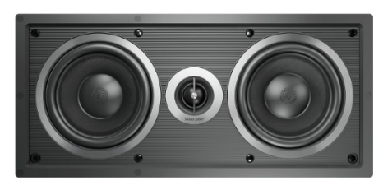
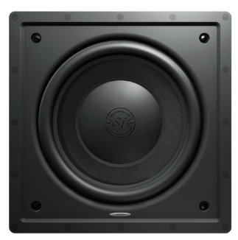
This “essential” combination of models is a perfectly balanced solution for traditional stereo system enthusiasts as much as for those looking to experience an home theater system.
Multiple choices of multichannel systems can easily be made pairing Lumina speakers with Gravis I and II and the Palladio Level 5 models.

Slide 8
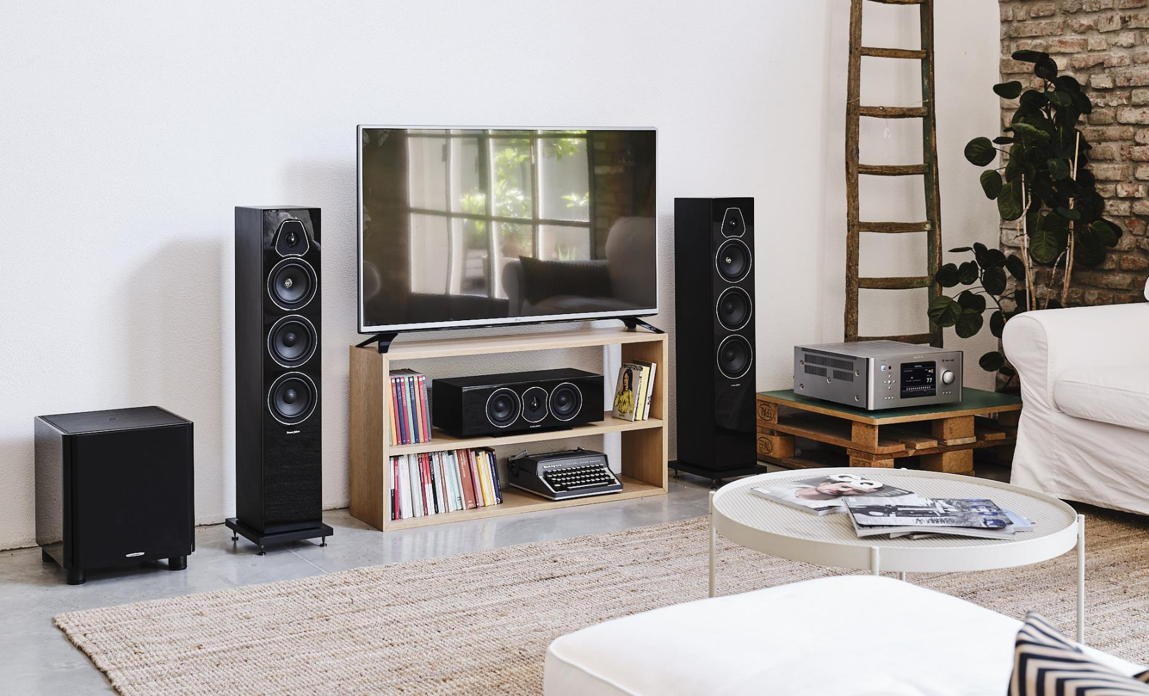

Slide 9
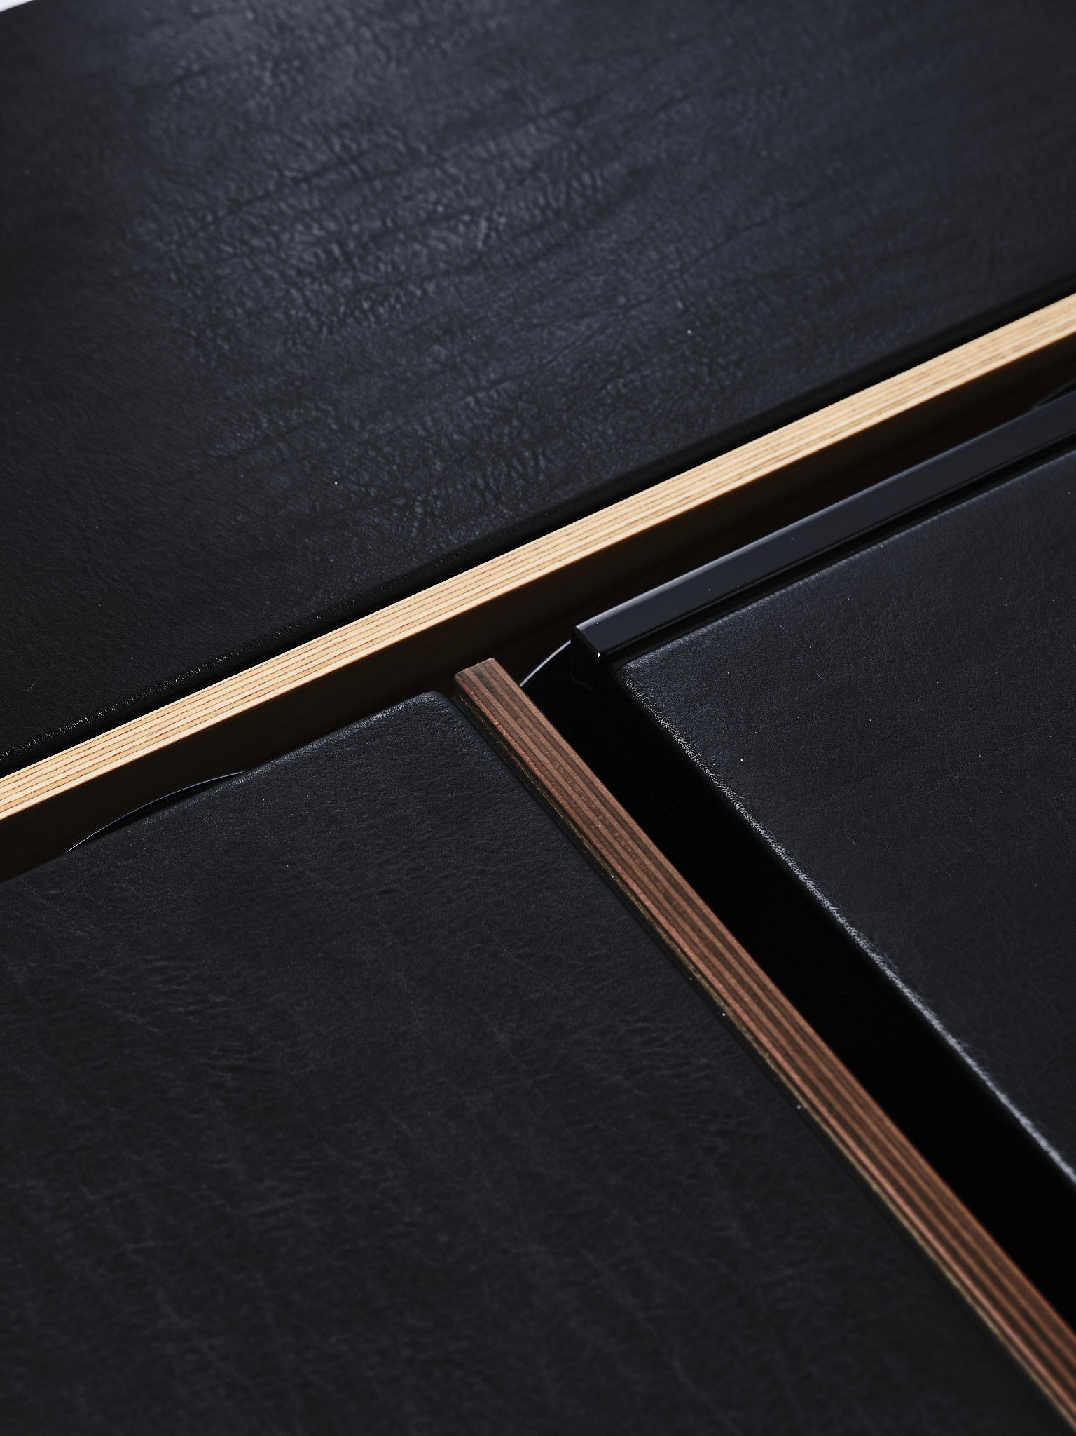
DESIGN
The cabinet of the collection is completely squared where the quality of materials play the role of protagonist. A careful study of proportions was carried out to guarantee accurate volumes for sound performances and compact dimension for the set-up.
Multilayer wood of the front baffle, unique feature in this price range.
Cabinet covered with our iconic black leather.

Slide 10
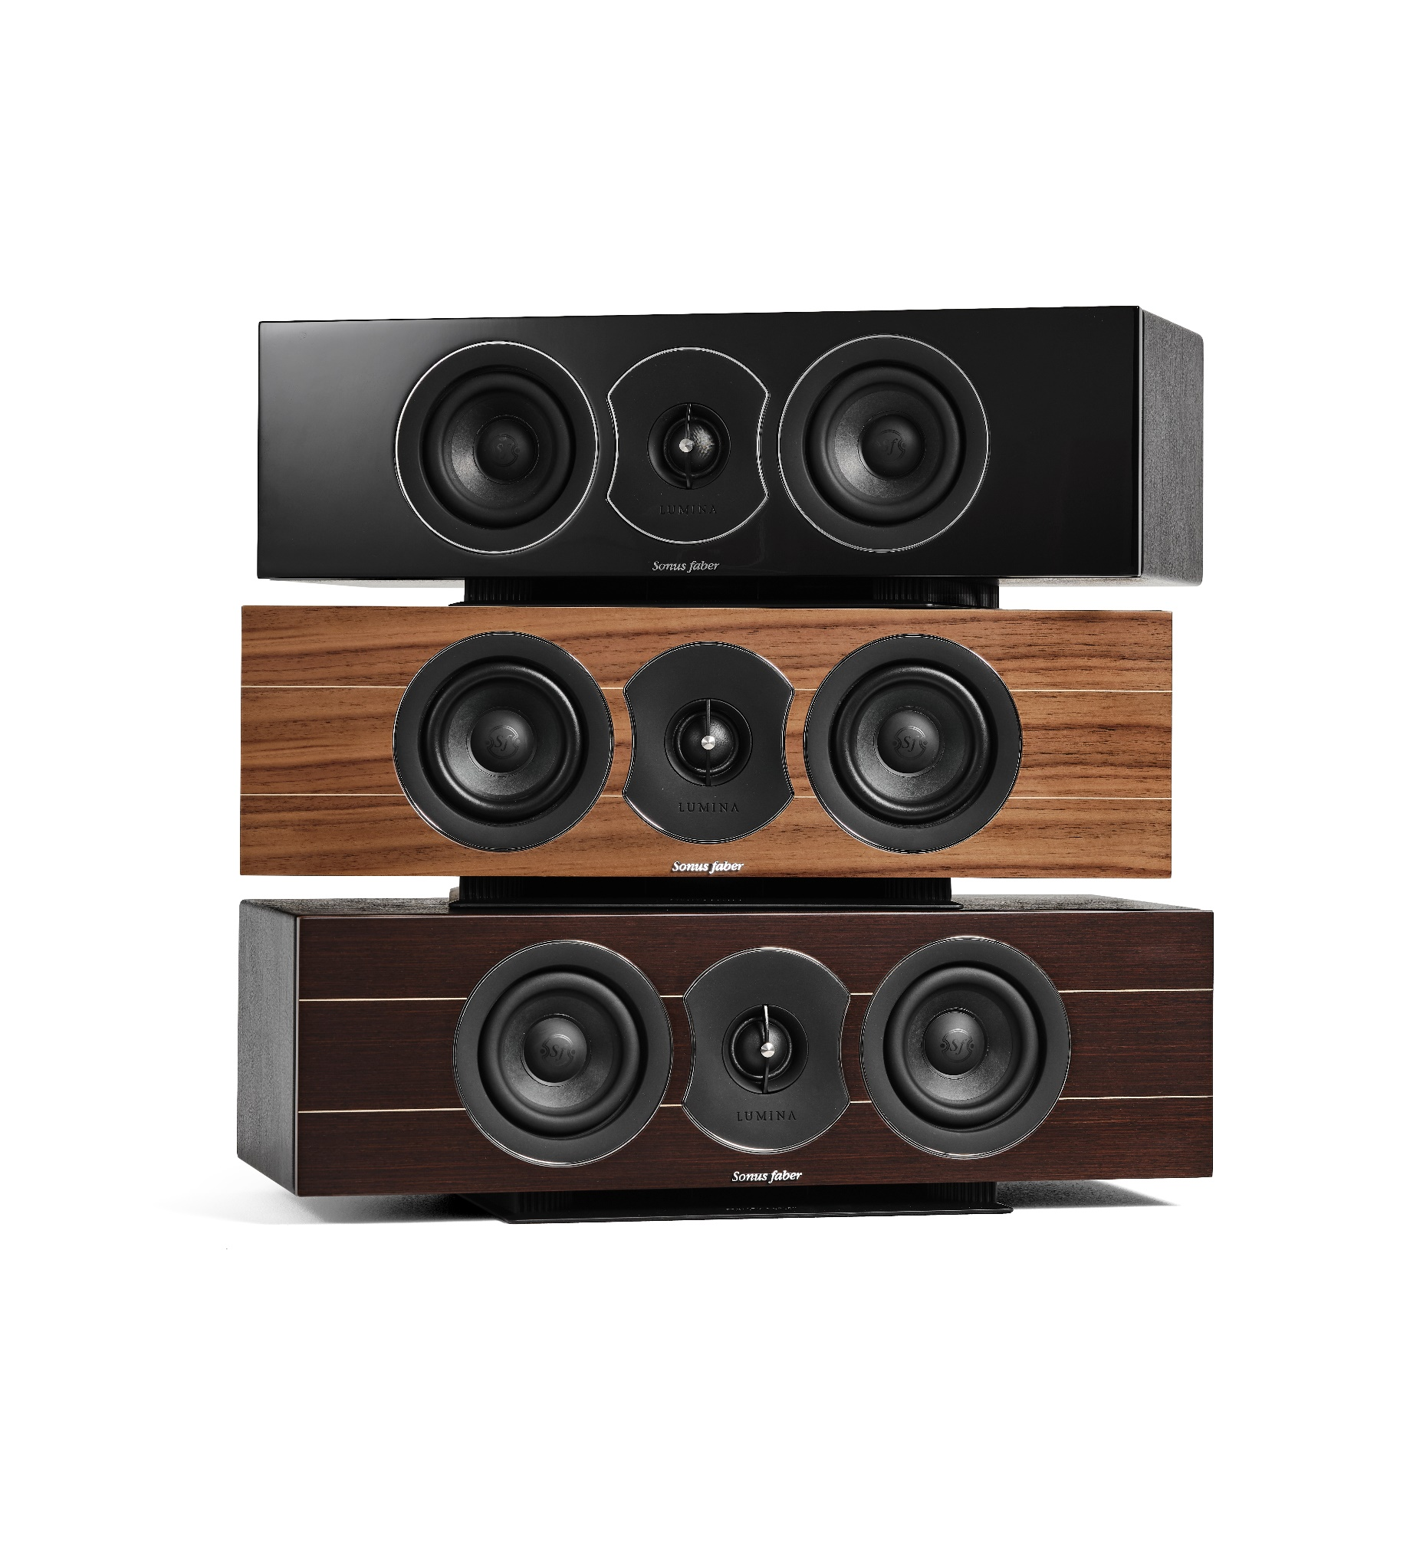
DETAILS
Lumina is available in the three iconic premium finishes: walnut with maple inlays and wengè with maple inlays, both in matte finish. A third option in piano black in also available, to fit in any kind of environment.
The chrome rings around the drivers highlight shapes and proportions and give brightness to the front baffle while outlining “The voice of Sonus faber”.

Slide 11
DRIVERS
The iconic D.A.D. (Damped Apex DomeTM) tweeter, the same used in the Sonetto series, featuring a Kurtmueller hand coated soft silk diaphragm of 29mm;
The brand-new 4’’ midwoofer, freshly developed for this collection, is equipped with the custom-made basket and the diaphragm based on cellulose pulp blended with other natural fibers;
The 5” midranges are coming from the bigger sisters Sonetto, and still featuring our proprietary natural fiber and paper blend air-dried diaphragm.
The 5’’ woofers were designed from the scratch for this purpose and feature paper pulp cone as well, for a perfect sonic coherence with the rest for the drivers.

Slide 12
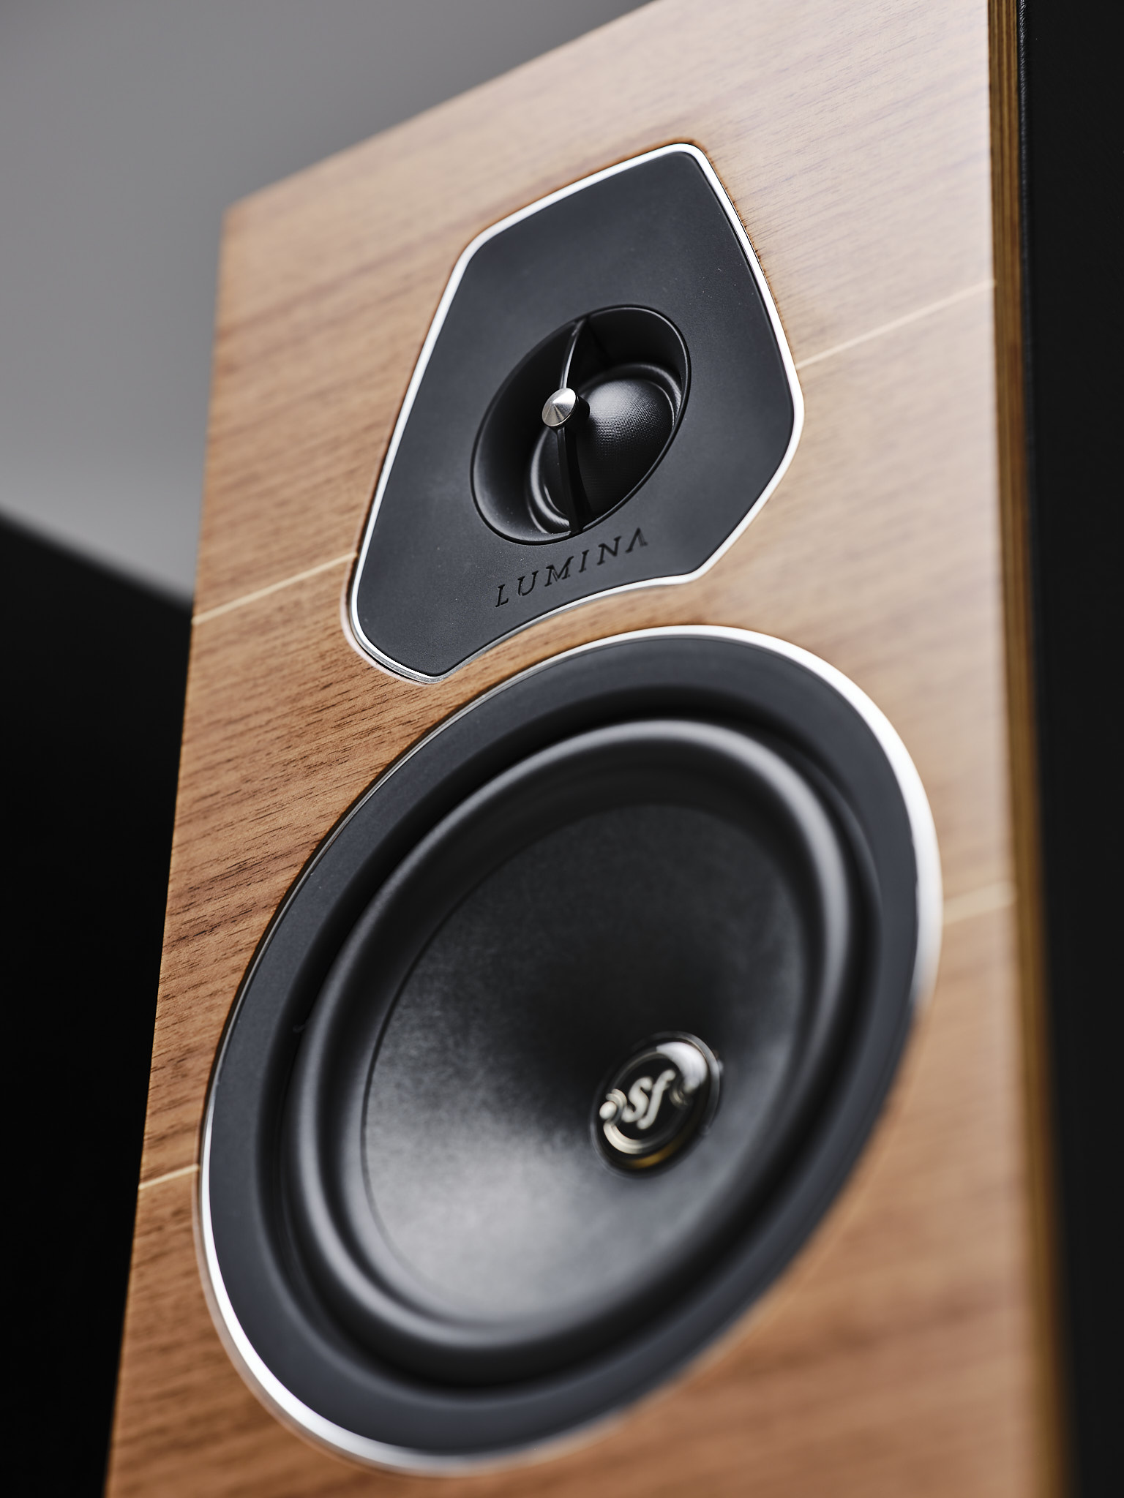
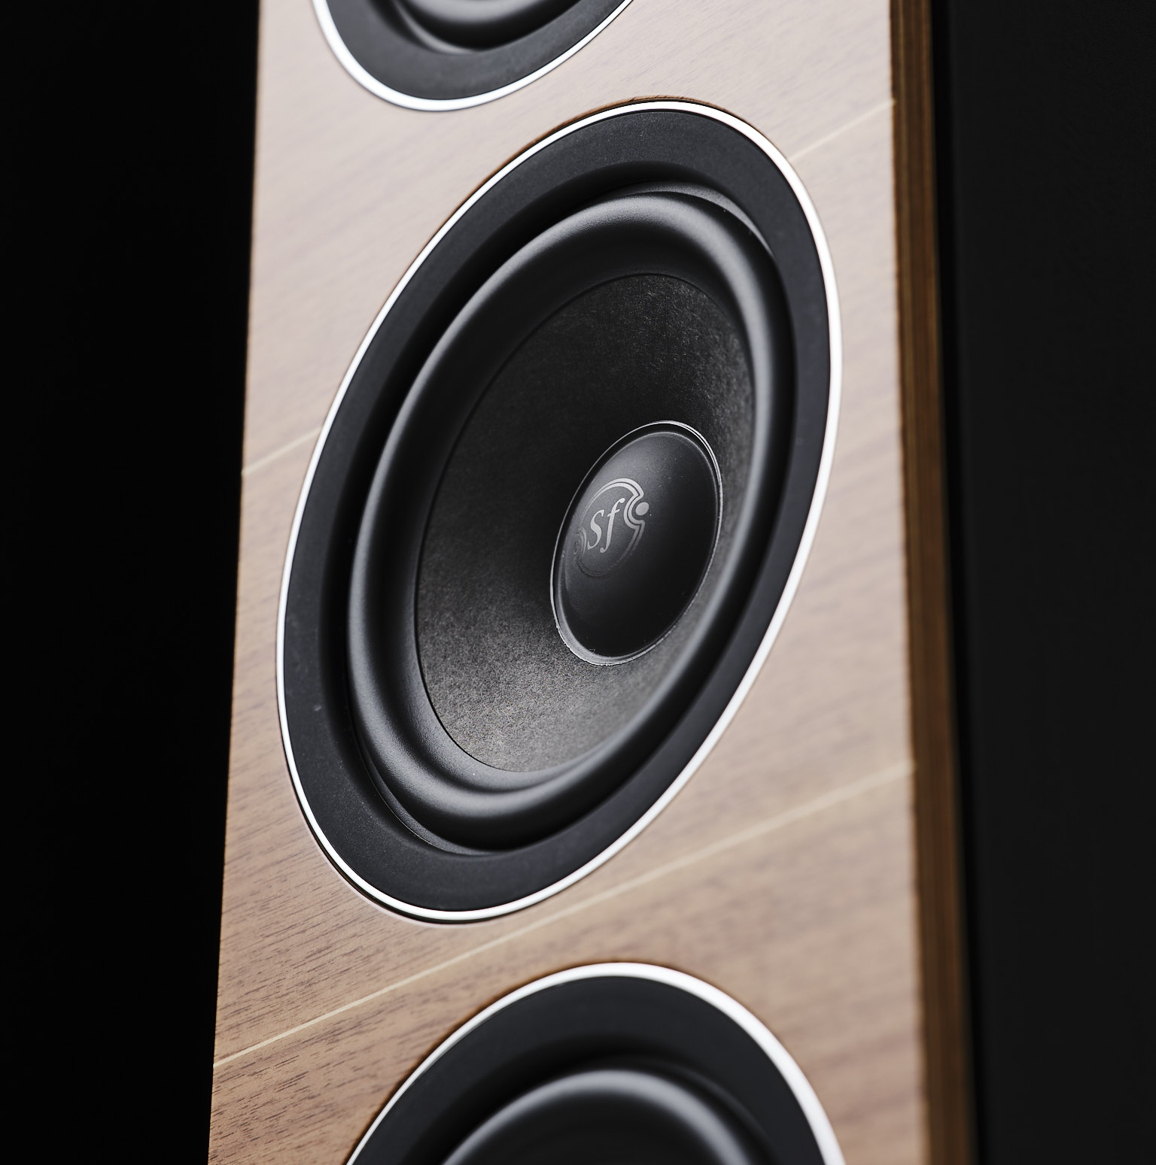

Slide 13
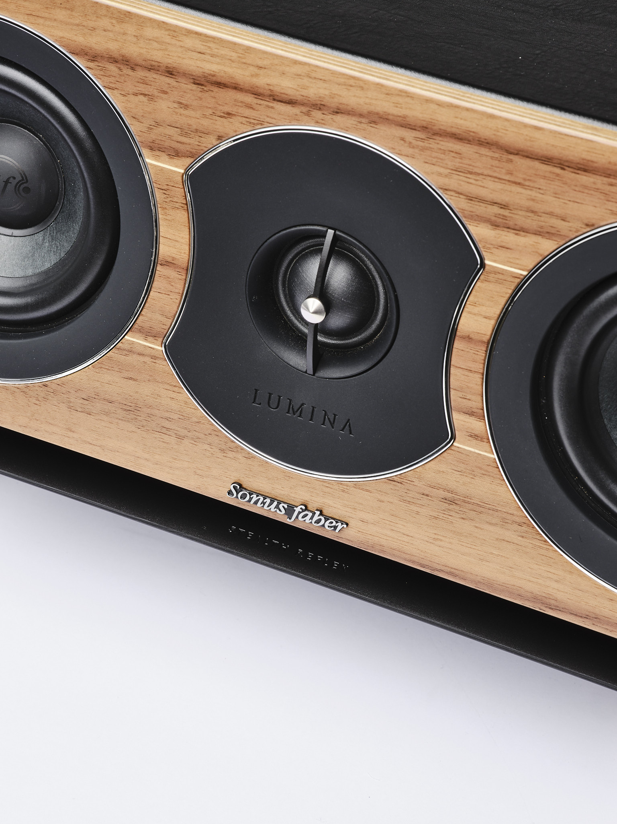
STEALTH REFLEX
The reflex ports give additional versatility for the models’ range, placed on the frontside of the bookshelf and center channel speakers and on the base, down firing, on the floor stander.
Thanks to this solution, Lumina speakers are way less sensitive to the placement allowing Luminas to sound excellent even when placed close to a backwall or in a bookshelf.
Luminas is that you can place them literally where you want and will be still sure to enjoy a great performance.

Slide 14
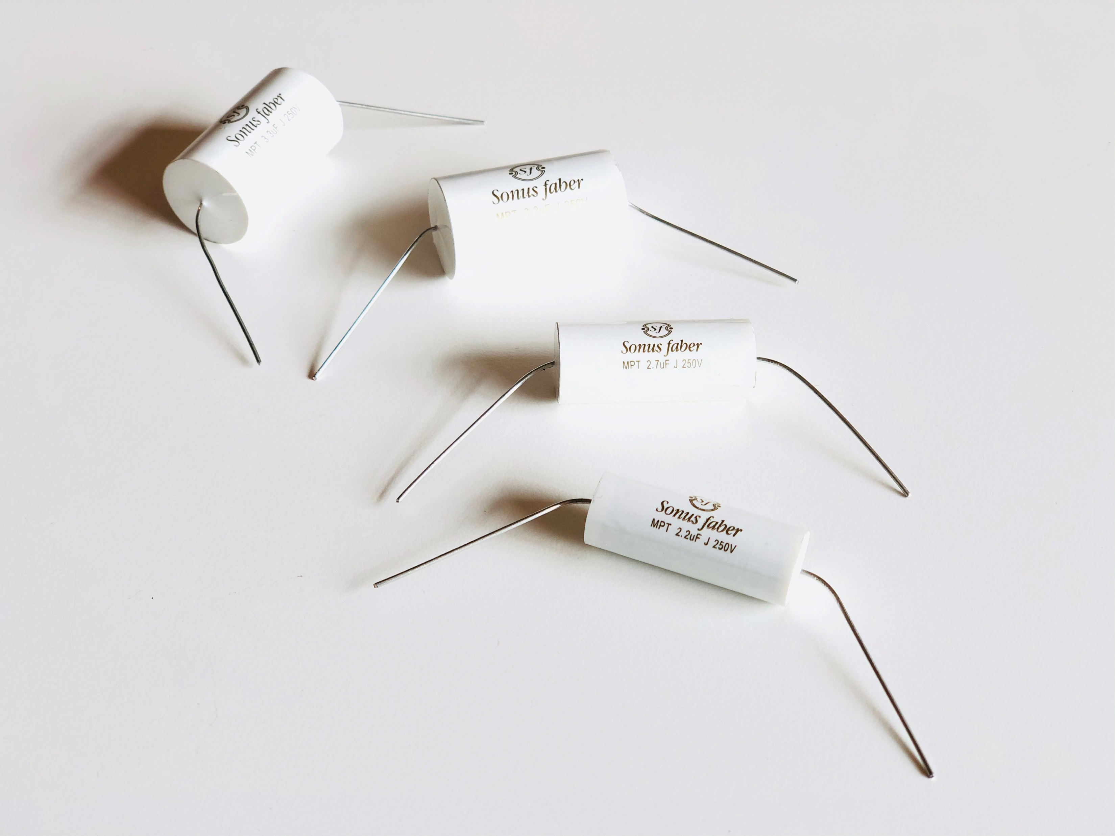
TERMINALS & CROSSOVER
Luminas are provided with two pairs of nickel plated terminals allowing for the upgrade experience provided by bi-wiring and bi-amping.
Luminas cross-over are featuring some specifically designed Sonus faber branded hi-quality capacitors.

Slide 15
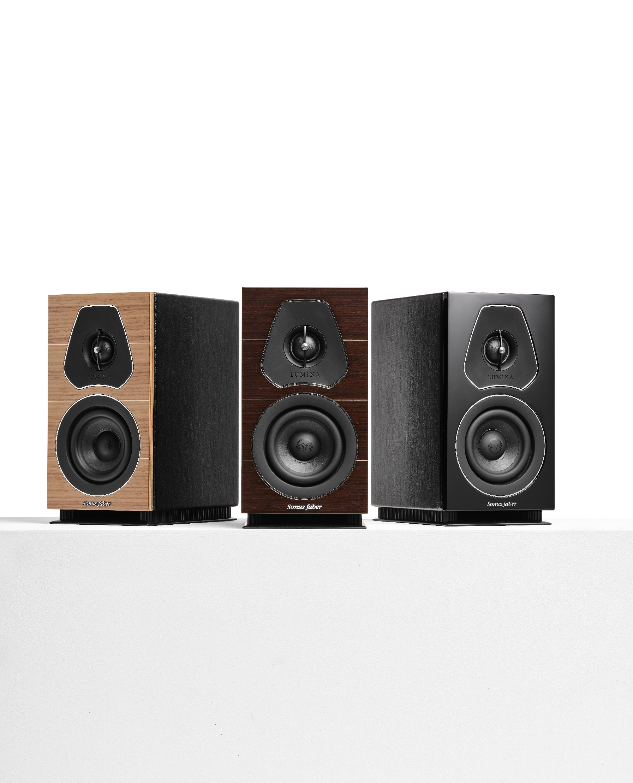
LUMINA I
The Lumina I is THE MOST COMPACT HIGH-END PASSIVE LOUDSPEAKERS in its category: this feature makes it extremely easy to place turning it into the perfect choice for smaller spaces. Despite its dimension, Lumina I is able to deliver tons of musical engagement.
System | 2-way shelf loudspeaker system. Vented box design.
Drivers | Tweeter: 29mm high definition DAD driver. Visco-elastically baffle decoupling. Sonus faber design. Midwoofer: 120mm cone driver. Ultra-free compression basket, Sonus faber design. Special custom diaphragm made with a blend of traditional cellulose pulp and other natural fibers, developed according to the most natural sound. Ultra-dynamic performance and high linearity.
Crossover | Optimized amplitude/phase response for optimal space/time performance. Crossover frequency: 2000 Hz.
Frequency response | 65 Hz -24.000 Hz
Sensitivity | 84dB SPL (2.83V/1m)
Nominal impedance | 4 ohm
Suggested amplifier power output | 30W – 100W undistorted signal
Long-term max input voltage (IEC-268-5) | 15.5V rms
Dimensions (HxWxD) | 280 x 148 x 213 mm / 11 x 5.8 x 8.4 in
Weight | 4.4 Kg each / 9.7 lb each
SMRP | € 799

Slide 16
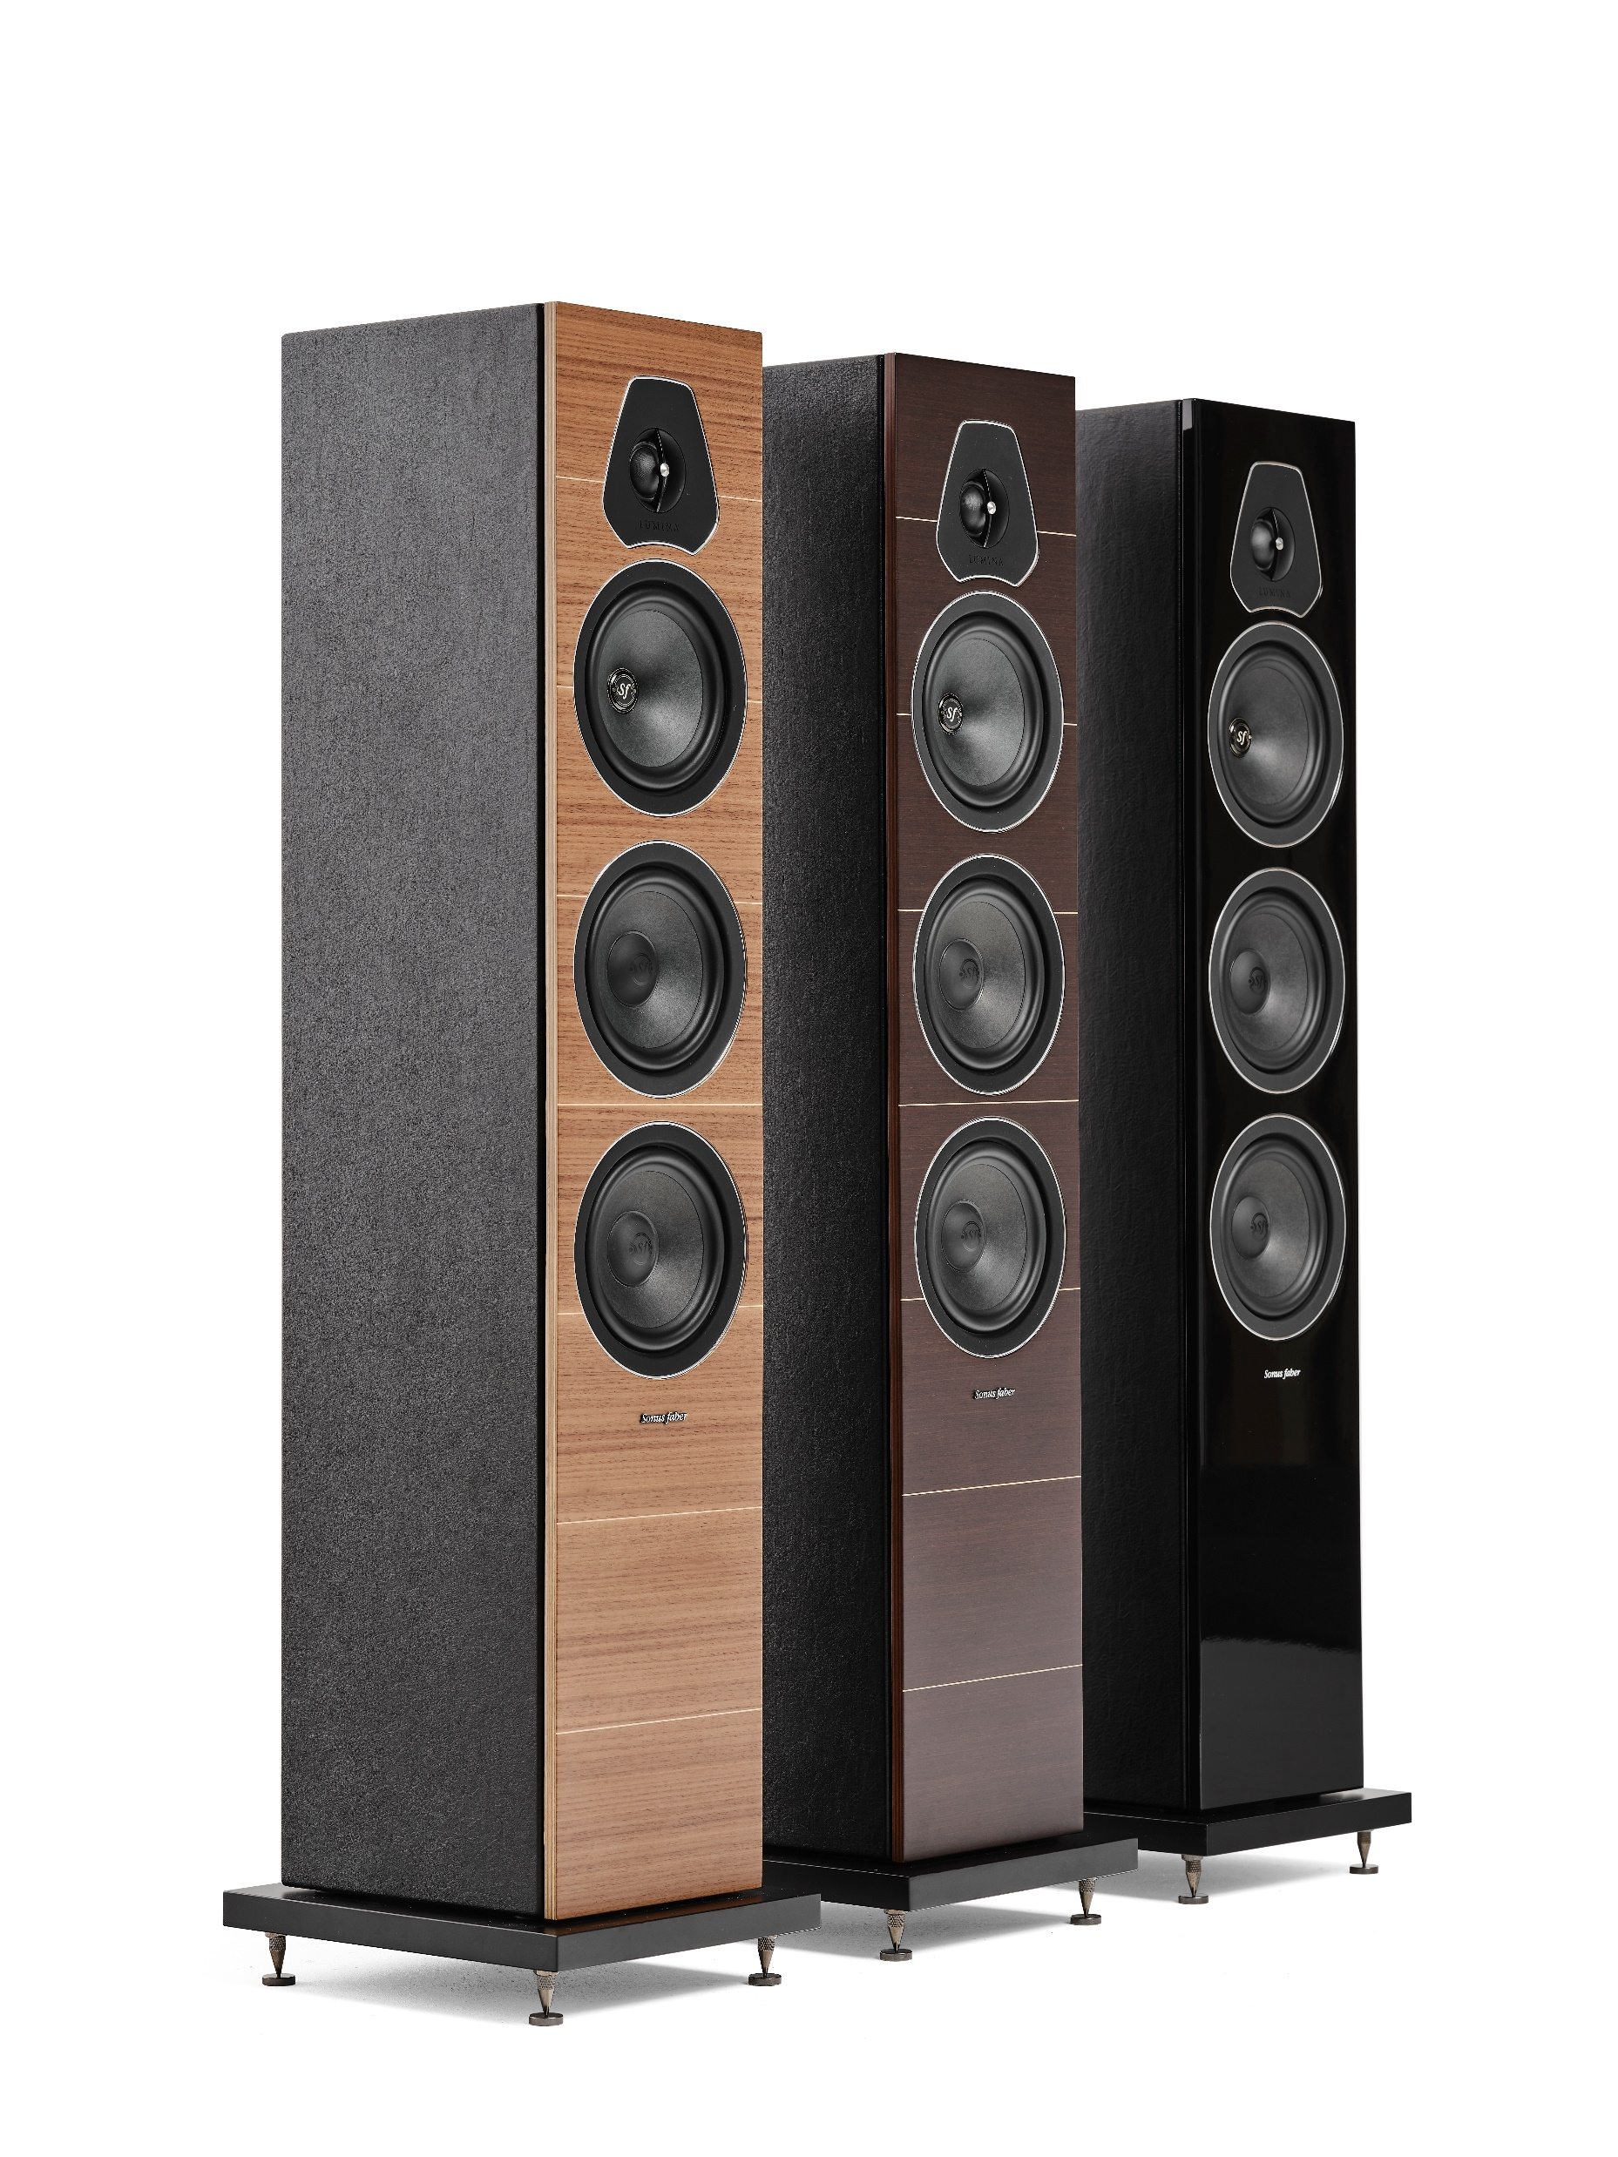
LUMINA III
The Lumina III is compact and elegant tower, the perfect choice for any MID-SIZED ROOM and able to provide a BROAD FREQUENCY RESPONSE, a gorgeous dynamic impact and a beautiful midrange presentation.
System | 3-way floorstanding loudspeaker system. Vented box design.
Drivers | Tweeter: 29mm high definition DAD driver. Visco-elastically baffle decoupling. Sonus faber design. Midrange: 150mm cone driver. Ultra-free compression basket, Sonus faber design. Special custom diaphragm made with a blend of traditional cellulose pulp and other natural fibers, developed according to the most natural sound. Ultra-dynamic performance and high linearity. Woofer: 2x150mm cone drivers. Ultra-free compression basket, Sonus faber design. Special custom diaphragm made with a blend of traditional cellulose pulp and other natural fibers, developed according to the most natural sound. Ultra-dynamic performance and high linearity.
Crossover | Optimized amplitude/phase response for optimal space/time performance “Para-cross topology”. Crossover frequencies: 350 and 3500 Hz.
Frequency response | 40 Hz – 24.000 Hz
Sensitivity | 89dB SPL (2.83V/1m)
Nominal impedance | 4 ohm
Suggested amplifier power output | 50W – 250W undistorted signal
Long-term max input voltage (IEC-268-5) | 22V rms
Dimensions (HxWxD) | 989 x 228 x 277,7 mm / 38,9 x 9 x 10,9 in
Weight | 15.9 Kg each / 35.1 lb each
SMRP | € 1.999

Slide 17
LUMINA CENTER I
Lumina Center I is the perfect complement for any MULTICHANNEL SET-UP.
System | 2-way shelf loudspeaker system. Vented box design.
Drivers | Tweeter: 29mm high definition DAD driver. Visco-elastically baffle decoupling. Sonus faber design. Midwoofer: 2 x 120mm cone drivers. Ultra-free compression basket, custom Sonus faber design. Special custom diaphragm made with a blend of traditional cellulose pulp and other natural fibers, developed according to the most natural sound. Ultra-dynamic performance and high linearity.
Crossover | Optimized amplitude/phase response for optimal space/time performance. Crossover frequency: 2000 Hz.
Frequency response | 65 Hz -24.000 Hz
Sensitivity | 87dB SPL (2.83V/1m)
Nominal impedance | 4 ohm
Suggested amplifier power output | 30W – 100W undistorted signal
Long-term max input voltage (IEC-268-5) | 15.5V rms
Dimensions (HxWxD) | 168,6 x 523,6 x 212,7 mm / 6,6 x 20,6 x 8,4 in
Weight | 7.6 Kg each / 16.8 lb each
SMRP | € 649

Slide 18
THANK YOU

