Slide 2
ALL WORK AND NO PLAY MAKES JACK A DULL BOY

Slide 4
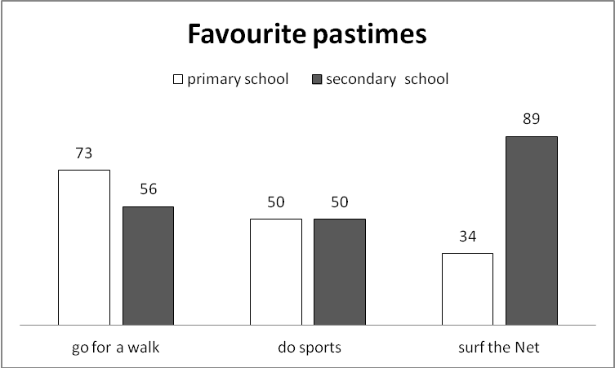

Slide 8
H
H

Slide 9
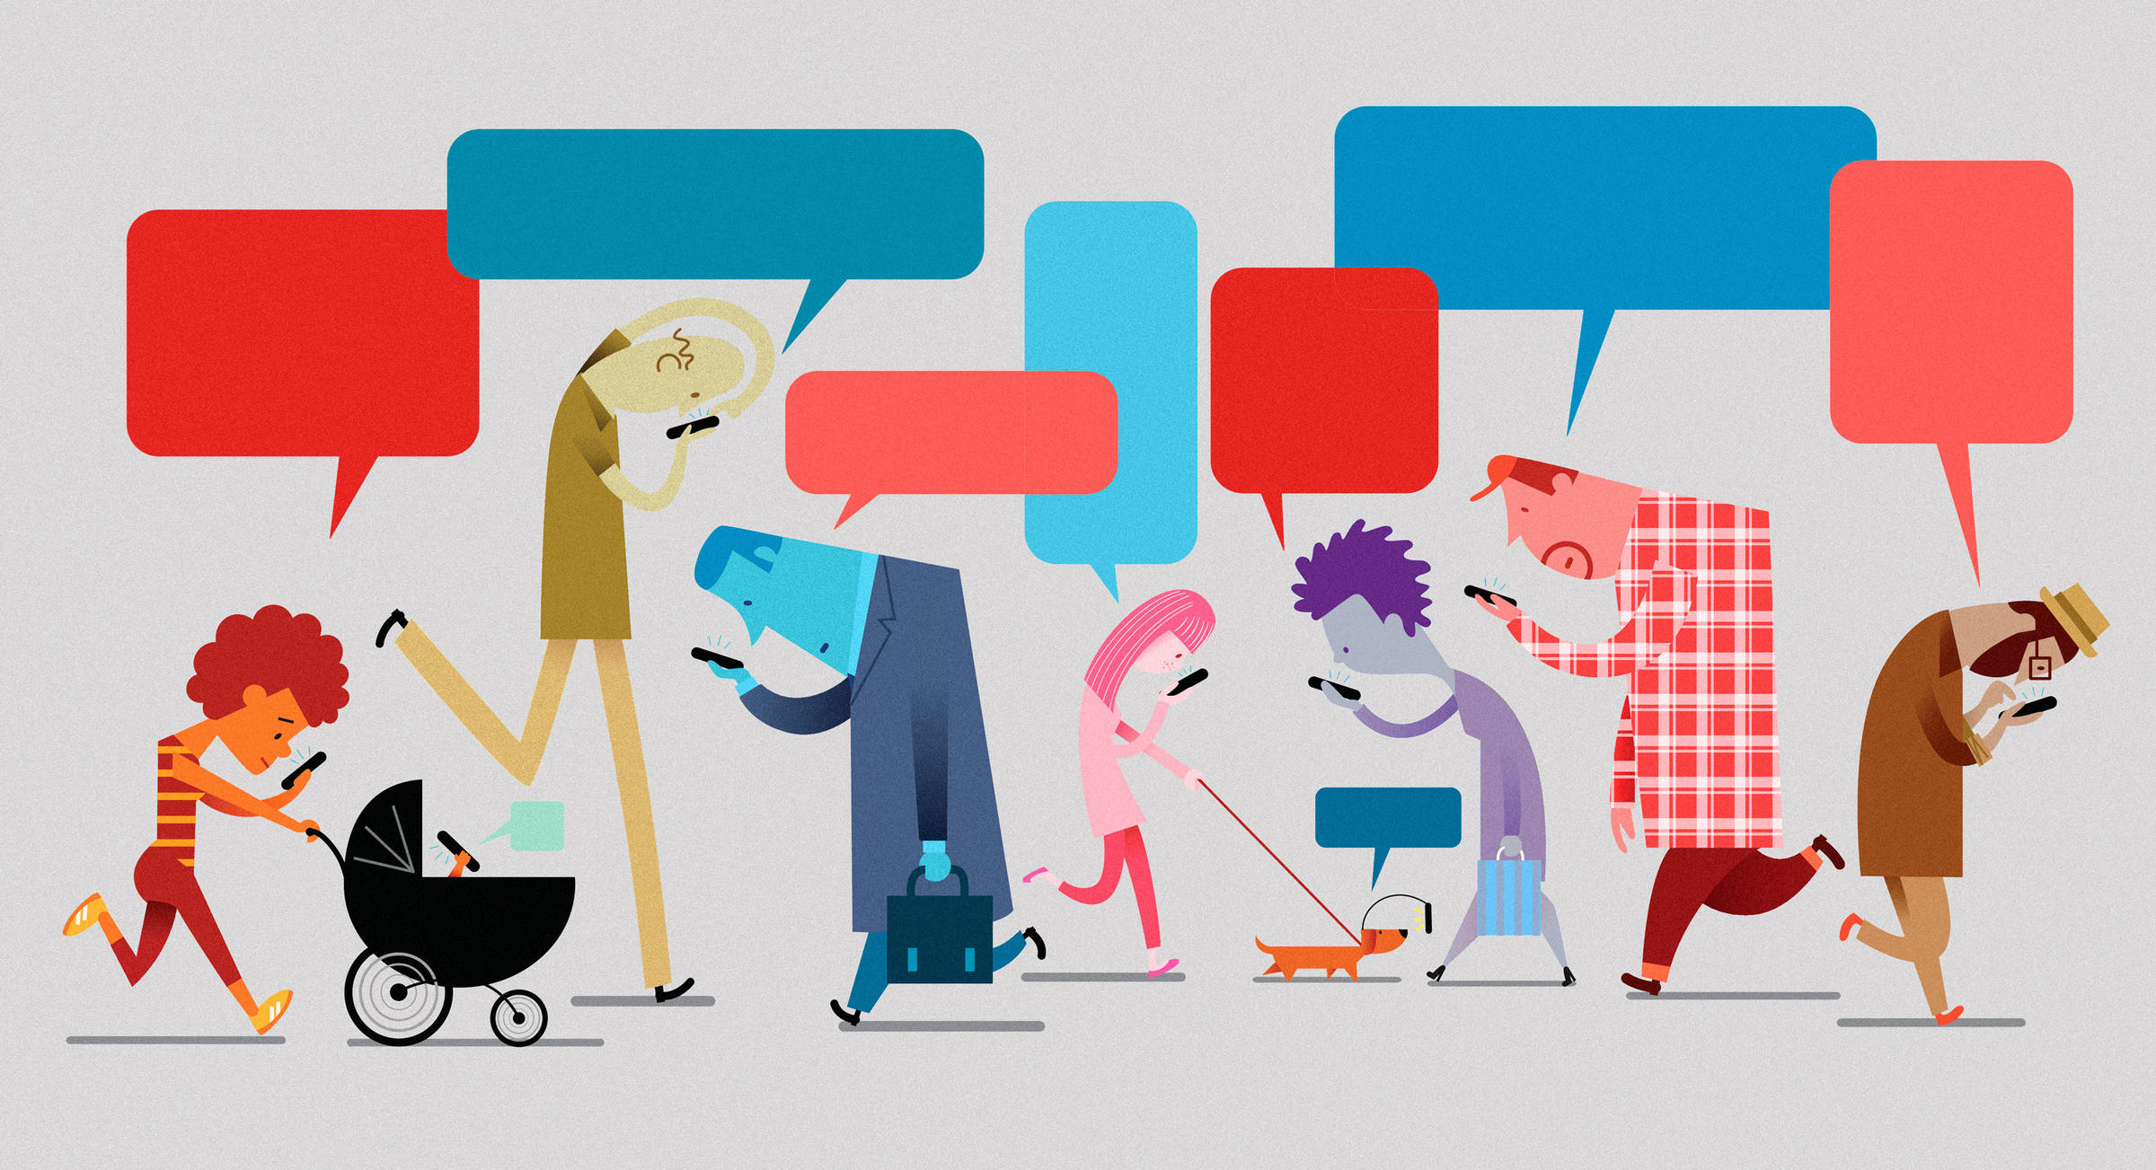

Slide 11
harmful content
hackers
spam
illegal and harmful actions
cheating on studies
health problems
depression
addiction

Slide 12
DOS
DON'TS

